Slide 1
Unit 1 Introduction to Java (Input-Processing-Output) Part 3 - Input
ICS3U/ICS3C

Slide 2
The Scanner Class
This is a group of commands that allows the user of the program to give input into the program.
The input can be of the form integer, decimal (Double) or string.

Slide 3
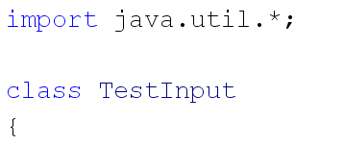
Scanner Setup
Before you use the scanner, you need to import this class of operations. It is within the “util” (utilities) class.

Slide 4
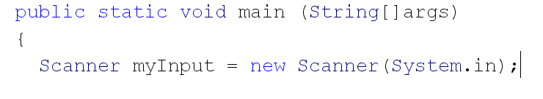
Scanner Setup
Within your main method, you need to create a new scanner object:

Slide 5
Getting input with scanner
The commands you can use with scanner are:
myInput.next() -> returns the next String
myInput.nextLine() ->returns characters up to the end of a line
myInput.nextInt() ->returns the next integer
myInput.nextDouble() -> returns the next decimal value

Slide 6
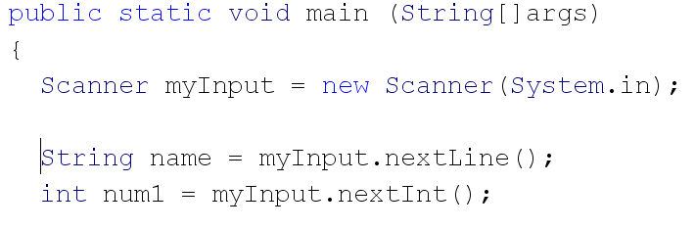
Examples:

Slide 7
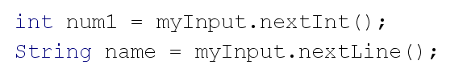
One Special Situation:
In some situations where you are using nextInt() or nextDouble() then using a nextLine() command, your program may not run properly:

Slide 8
One Special Situation:
This is because the nextInt() only takes the integer value, not the <enter>
when the nextLine() runs, the <enter> you push after the integer gets “used up”
The solution to this is on the next slide:

Slide 9
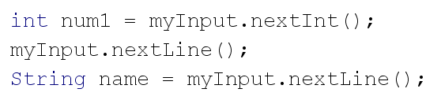
One Special Situation:
Insert a nextLine() after a nextInt() or multiple nextInt() commands

Slide 10
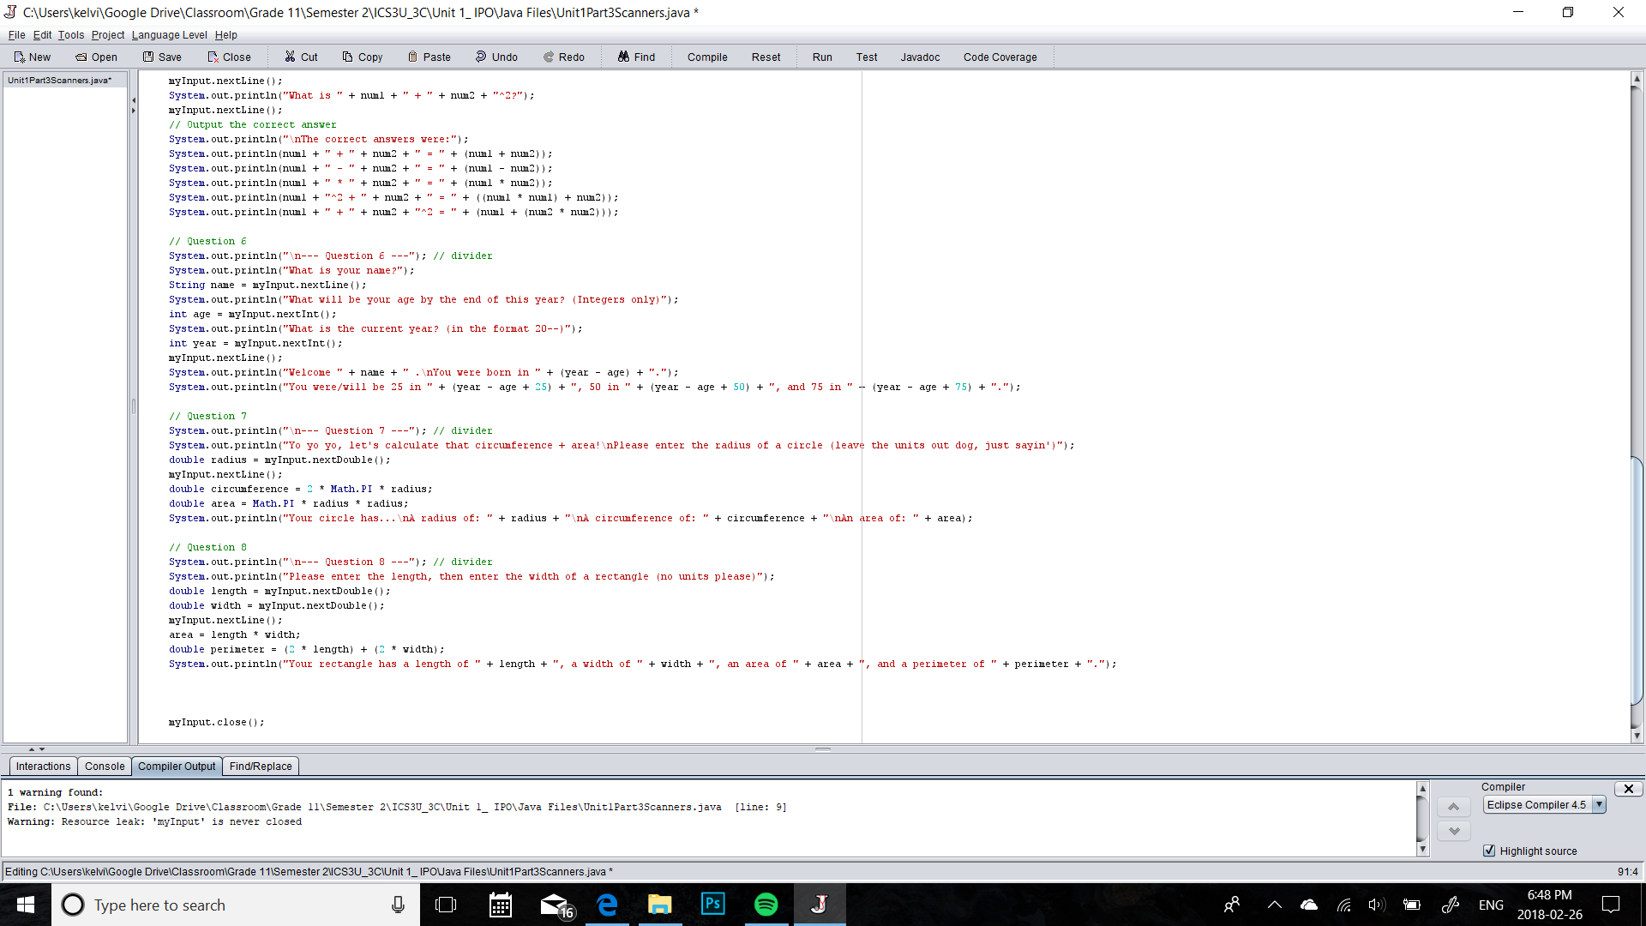
Closing scanners
Scanners run in the background of your program, so to save resources, Dr. Java expects you to close resources when you are finished with them, and will throw this warning:

Slide 11
Closing scanners
To fix this, we simply close the Scanner at the end of the program (watch your capitalization):
This line can go anywhere in the main method after you are done with your Scanner.

